Slide 1
Employee payroll management
Projected By:- Group 2

Slide 2
Team Members:-
Names Emp Id
Cheekoti Ramya 2488932
Pasala Siva Krishna 2489155
Chennu Naveen Varma 2489184
Kancherla Jagadeesh 2489206
Manjunath Sidram Sarwadkar 2489229
Palepu Achyuth Varma 2489329
Niranjan J 2489485
Majji Poojitha 2489536
Tanmay Khandual 2491802

Slide 3
Introduction:
The proposed project “Employee Payroll Management System” has been developed to overcome the problems faced in the practicing of manual system. This software is built to eliminate and in some cases reduce the hardships faced by the existing system. Moreover this system is designed for particular need of the company to carry out its operations in a smooth and effective manner. This web application is reduced as much as possible to avoid errors while entering data.

Slide 4
Tools & Technologies:-
Server side: Spring Boot, Spring Cloud, Spring DataJPA
DataBase: MySQL, H2
Server: Embedded Tomcat
Devops: Git Hub, Docker

Slide 5
Java MicroServices Modules:-
In our project we used 6 Microservices
Admin Attendance
Admin Salary
Admin Leave
Admin Work Schedule
Employee Details
User

Slide 6
Creating Attendance Entity:-
1. Create an Entity: Attendance
2. Create a Attendance Repository interface and will make use of Spring Data JPA
a)Will have find By Employee Id method.
b) Add the Attendance details method.
c) Will have delete Employee By Id method.
d)Will have find All Employee Attendance method.
3. Create a Attendance Service class and will expose all these services.
4. Finally, create a Attendance Rest Controller will have that code in backend program.

Slide 7
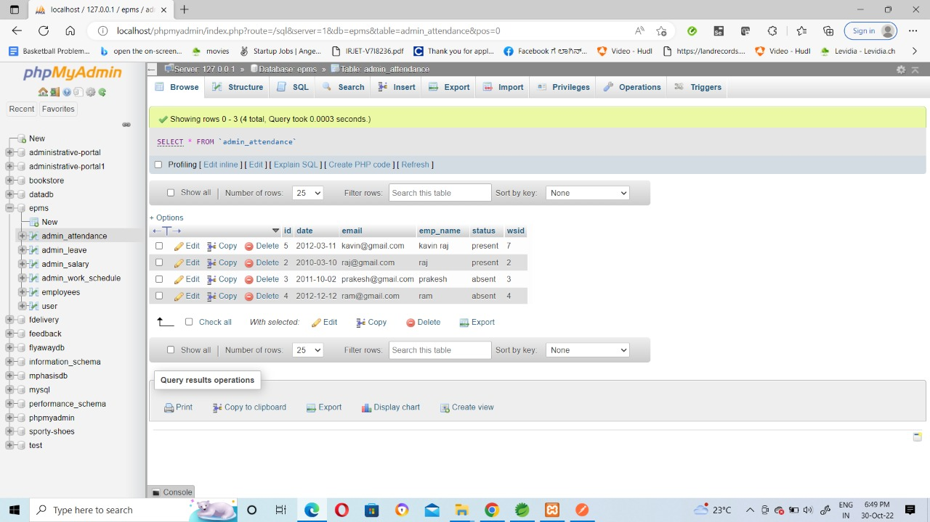

Slide 8
Creating Salary Entity:-
1. Create an Entity: Salary
2. Create a Salary Repository interface and will make use of Spring Data JPA
a)Will have find By Employee Id method.
b) Add the Salary details method.
c) Will have delete Employee By Id method.
d) Will have find All Employee Salary method.
3. Create a Salary Service class and will expose all these services.
4. Finally, create a Salary Rest Controller will have that code in backend program.

Slide 9
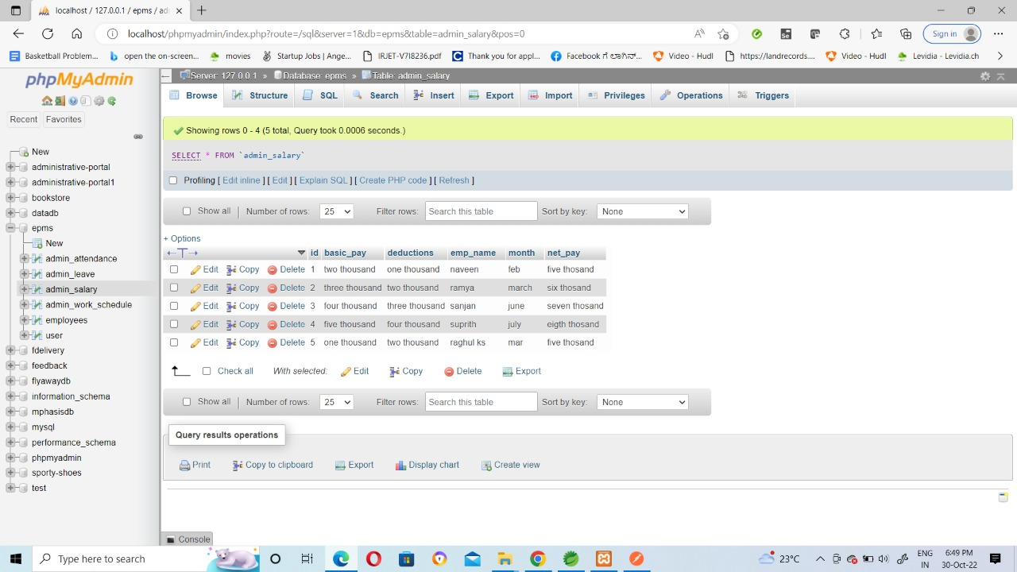

Slide 10
Creating Leave Entity:-
1. Create an Entity: Leave
2. Create a Leave Repository interface and will make use of Spring Data JPA
a) Will have find By Employee Id method.
b) Add the Leave details method.
c) Will have delete Employee By Id method.
d) Will have find All Employee Leave method.
3. Create a Leave Service class and will expose all these services.
4. Finally, create a Leave Rest Controller will have that code in backend program.

Slide 11
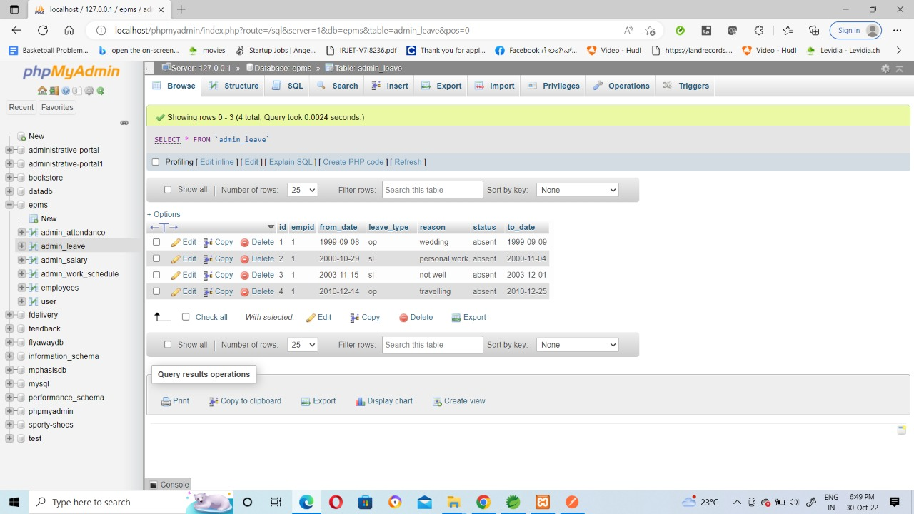

Slide 12
Creating WorkSchedule Entity:-
1. Create an Entity: WorkSchedule
2. Create a WorkSchedule Repository interface and will make use of Spring Data JPA
a) Will have find By Employee Id method to get the workschedule details.
b) Add the workschedule details method.
c) Will have a delete Employee By Id method to delete the workschedule.
d) Will have find All Employee workschedule method.
3. Create a workschedule Service class and will expose all these services.
4. Finally, create a workschedule Rest Controller will have that code in backend program.

Slide 13
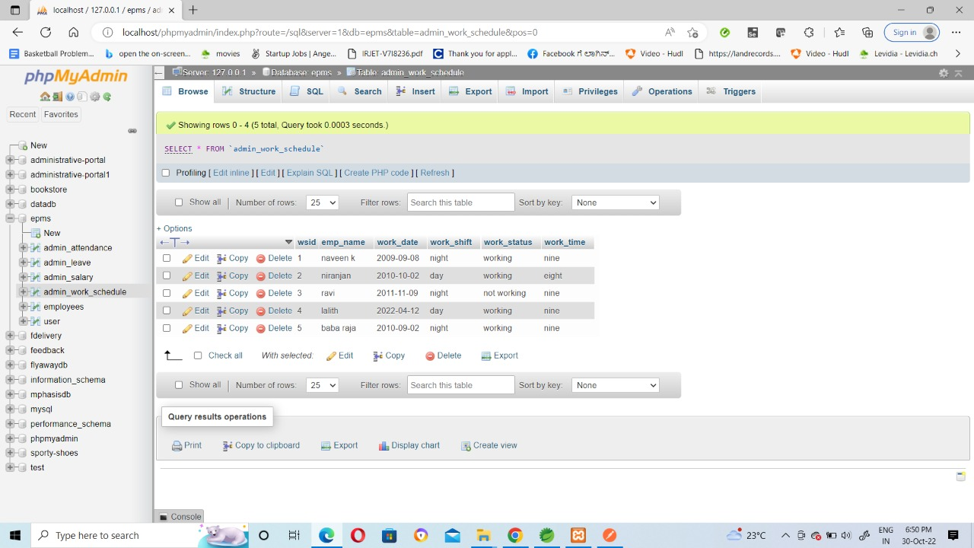

Slide 14
Creating Employee Details Entity:-
1. Create an Entity: Employee Details
2. Create a Employee Repository interface and will make use of Spring Data JPA
a)Will have find By Employee Id method.
b) Add the Attendance details method.
c) Will have delete Employee By Id method.
d)Will have find All Employee Attendance method.
3. Create a Attendance Service class and will expose all these services.
4. Finally, create a Attendance Rest Controller will have that code in backend program.

Slide 15
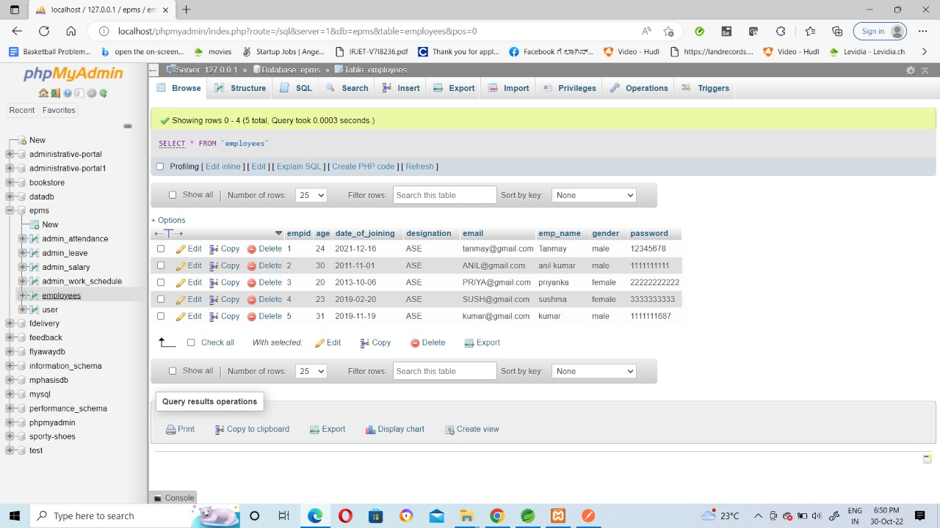

Slide 16
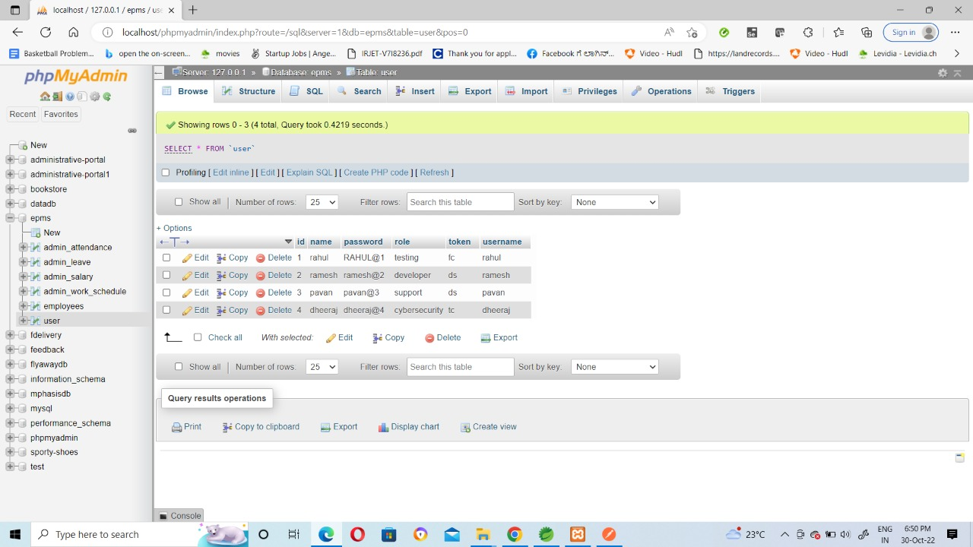
USER TABLE

Slide 17
Configure Server:-
Spring cloud config is spring’s client/server apporoach for storing and serving distributed configurations across multiple applications and environments.
This configuration store is ideally versioned under Git version control and can be modified at application runtime.

Slide 18
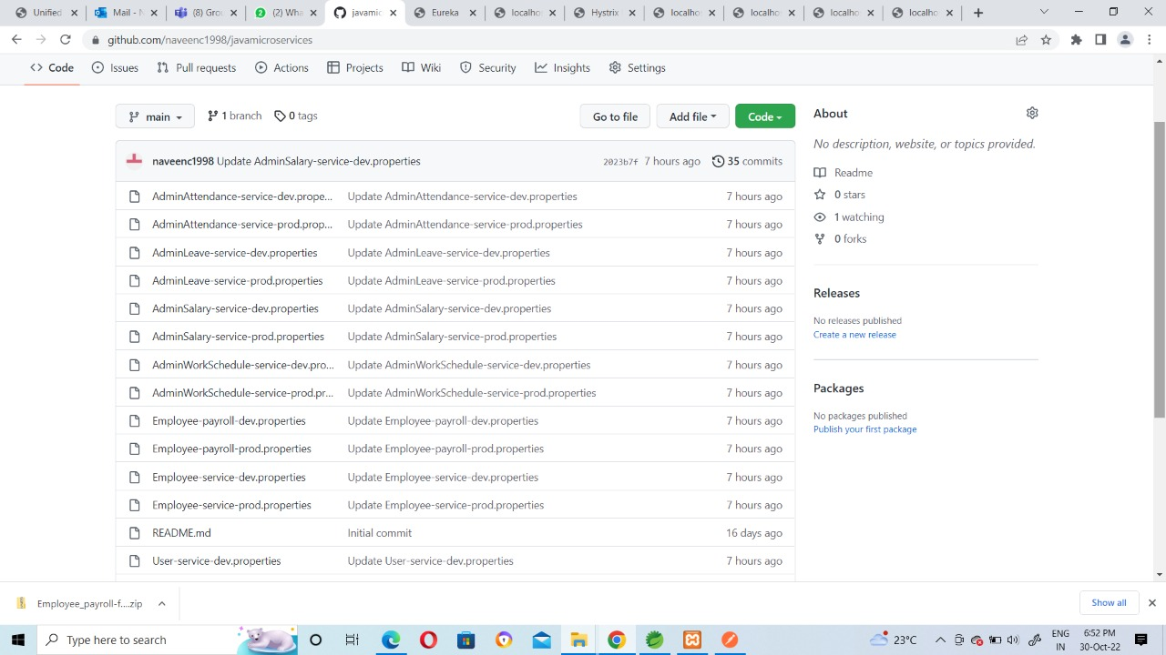

Slide 19
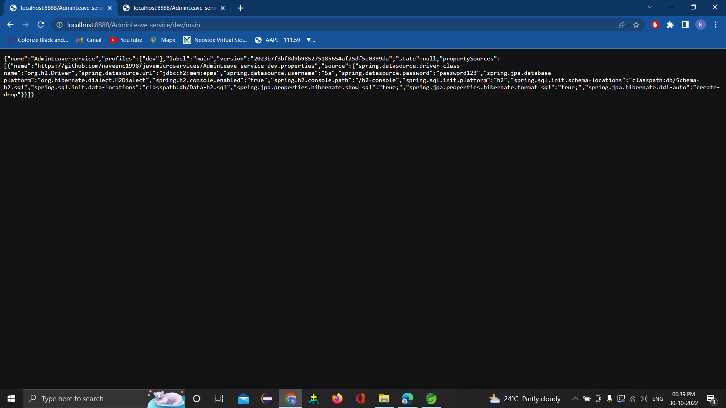

Slide 20
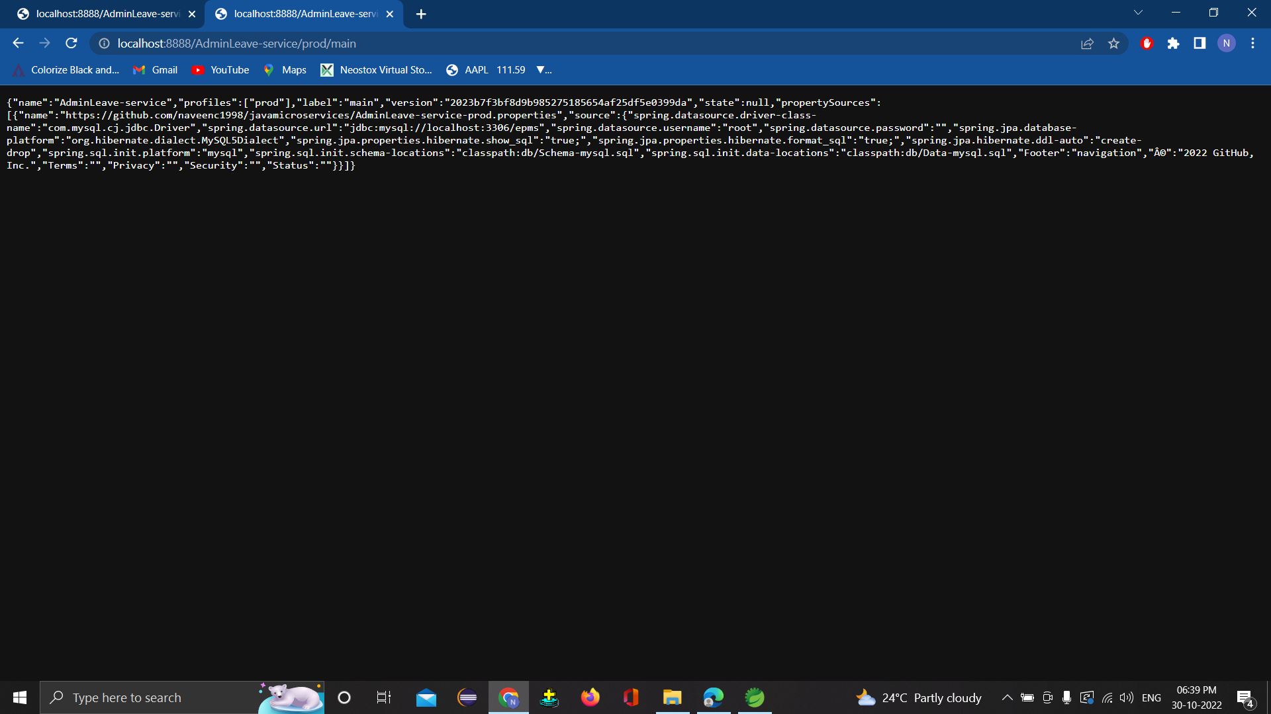

Slide 21
Configure Client:-
A client configuration provides settings that define a client and how it should operate in the network.
Each configuration includes settings for the server that should be used by the client in its attempts to work with database.

Slide 22
Eureka:-
Eureka server is application that holds the information about all client-service applications.
Each microservice registers itself with the eureka naming server.
All the client applications running on each port and IP address.

Slide 23
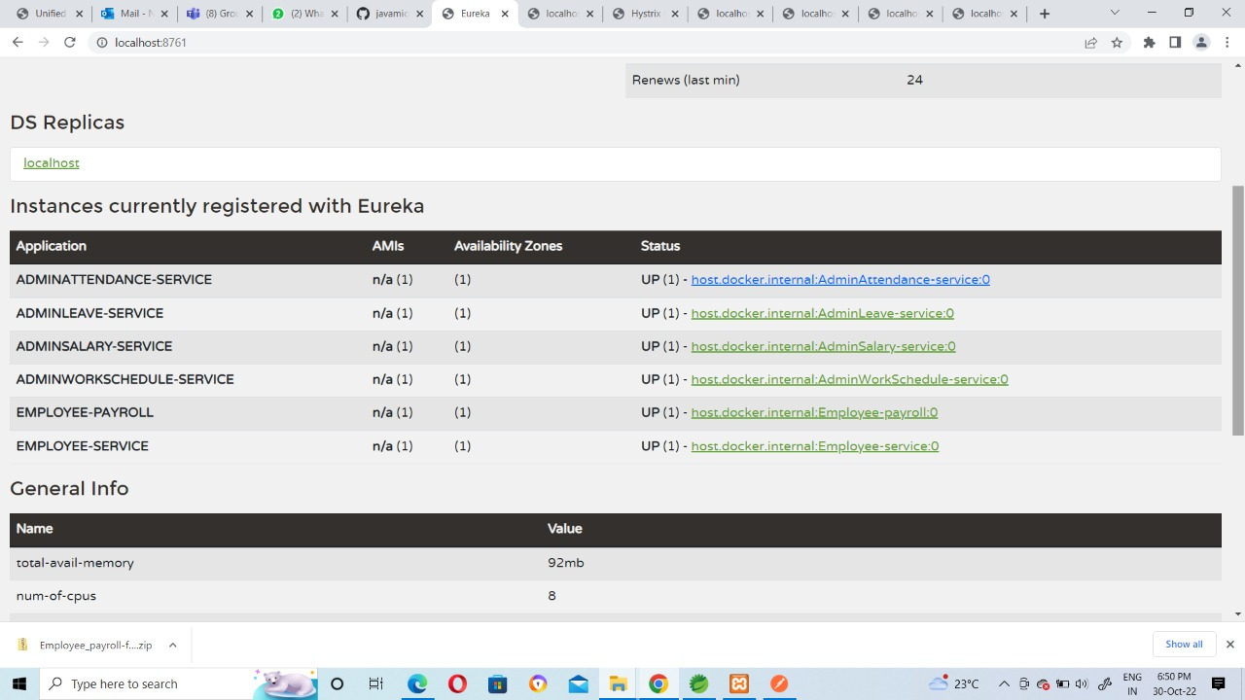

Slide 24
Service to Service:-
For a given state change a microservice publishes an event to a message broker making it aviliable to any other intrested microservice
Service to service communication is difficult to when you build microservises.
This application typically runs on a single process and they can interact with each other using a communication protocol.

Slide 25
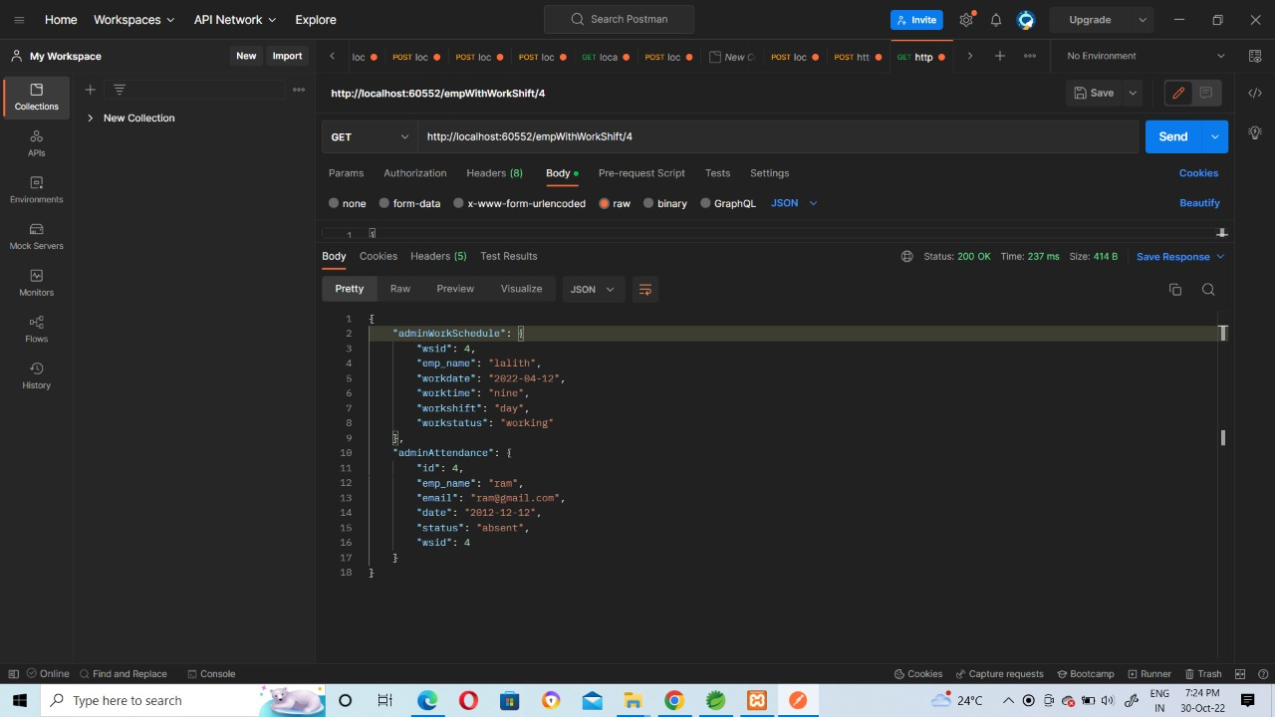

Slide 26
Hystrix:-
Hystrix is a library that controls the interaction between microservises to provide latency and fault tolerance
In this Hystrix we used two methods
Feign Using Fallback:-
Feign is a declartive web service client which comes with hystrix built it when you use it.
Hystrix supports the notion of a fallback with a default code path that is executed when the circuit is open
To enable the fallback for a given feign client we have to set the fallback attributes to the class name that implements the fallback

Slide 27
Hystrix Dashboard:-
It is an web application that provides a dashboard for monitoring applications using Hystrix.
This application is not to be deployed on untrusted networks and without any external authentication and authorization.
One of the main benefit of hystix dashboard is the set of metrics it gathered about each hystrix command.
This dashboard displays the health of each circuit breaker in an efficient manner.

Slide 28
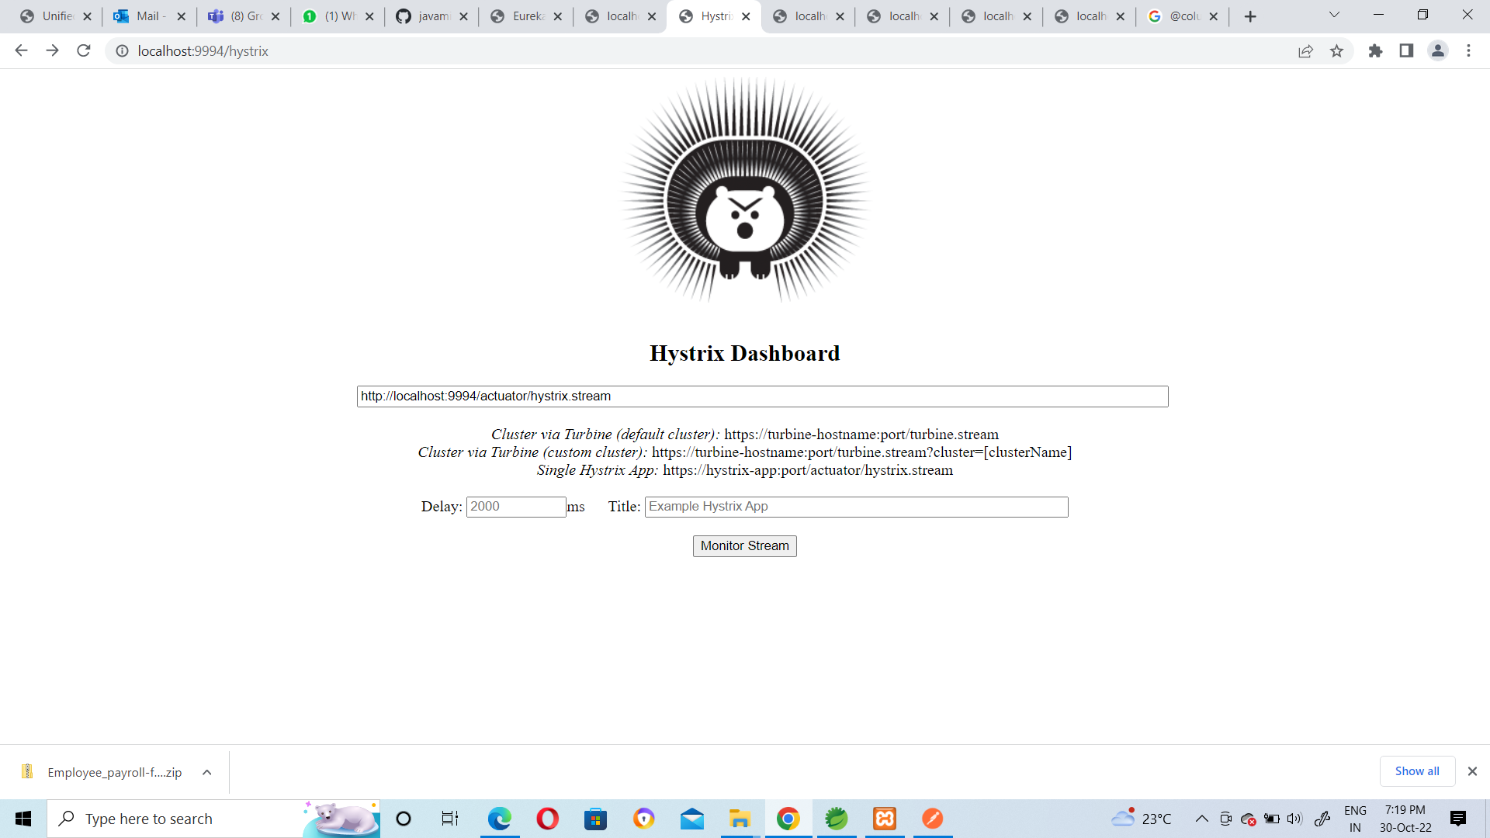

Slide 29
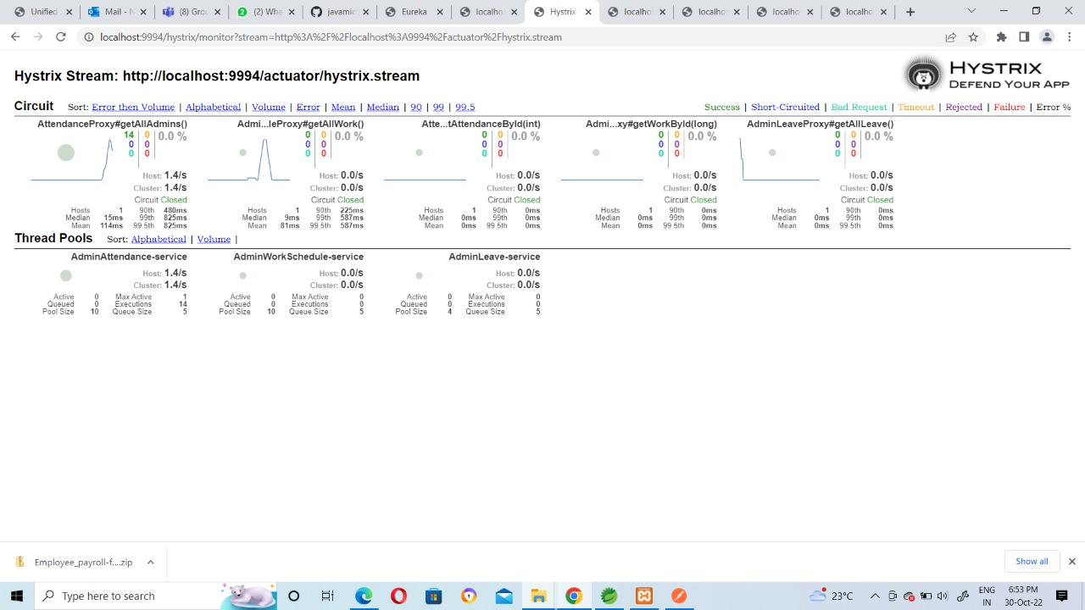

Slide 30
Docker
Docker Hub is a hosted repository service provided by Docker for finding and sharing container images with your team.
Docker is an open platform for developing, shipping, and running applications.
Docker enables you to separate your applications from your infrastructure so you can deliver software quickly.

Slide 31
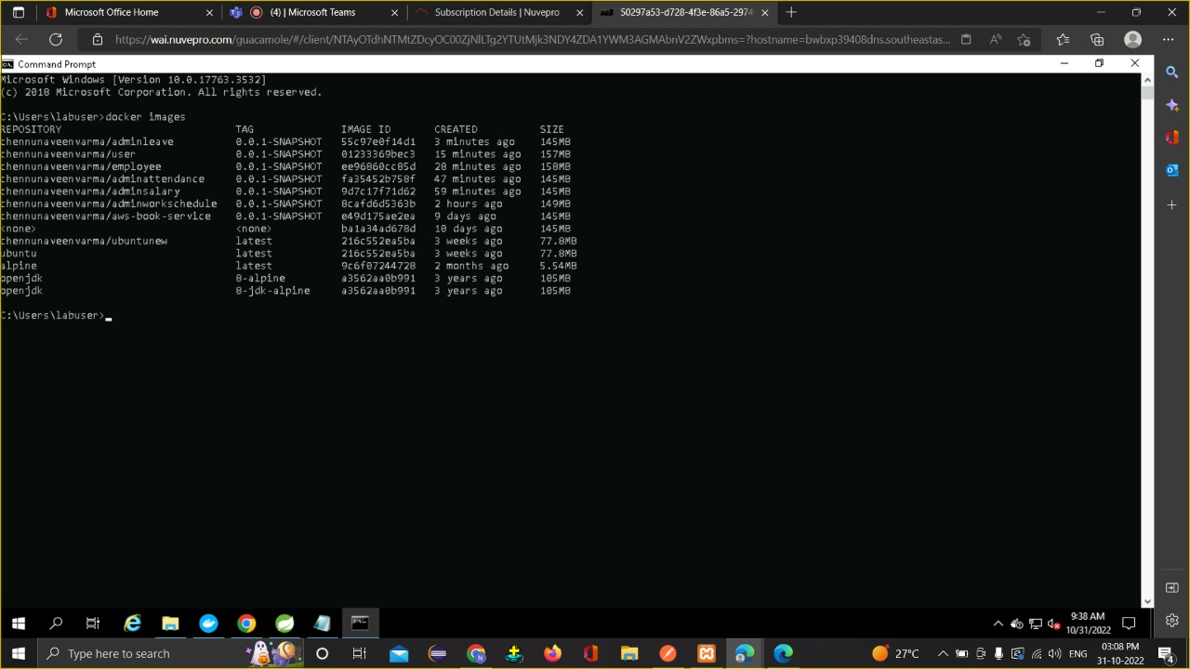
All Docker Images (command :docker images)

Slide 32
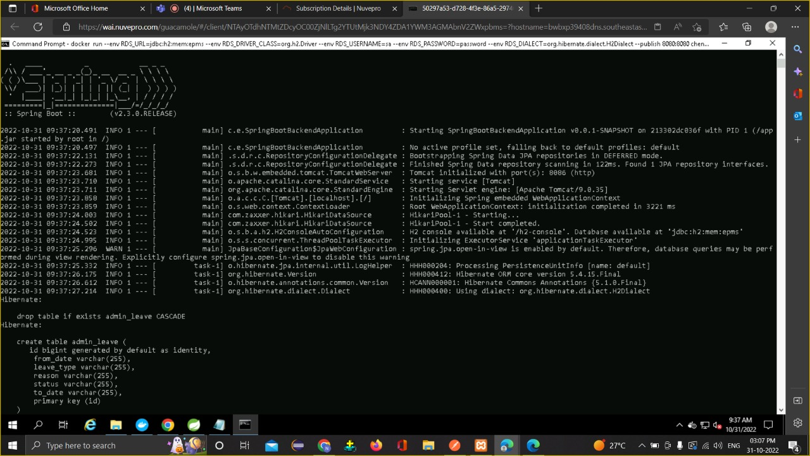
Docker Images Output : Admin Leaves

Slide 33
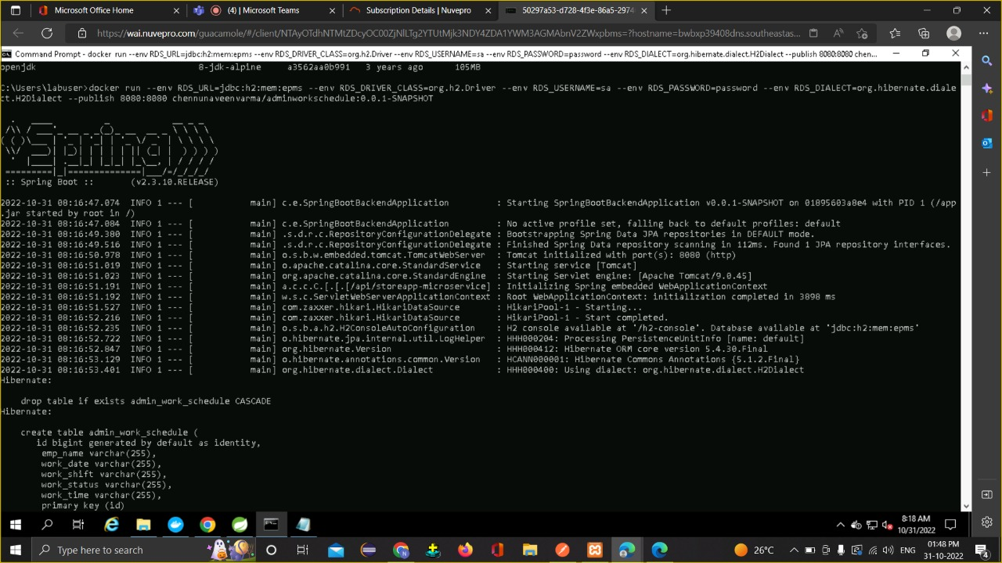
Docker Images Output : Admin Workschedule

Slide 34
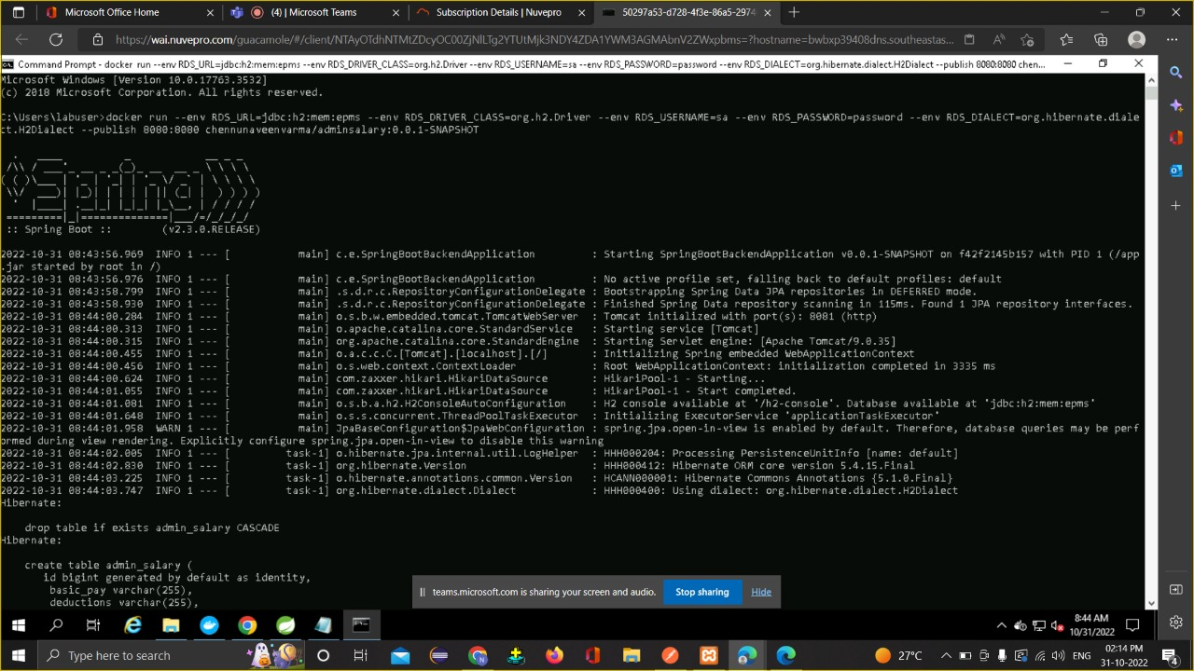
Docker Images Output : Admin Salary

Slide 35
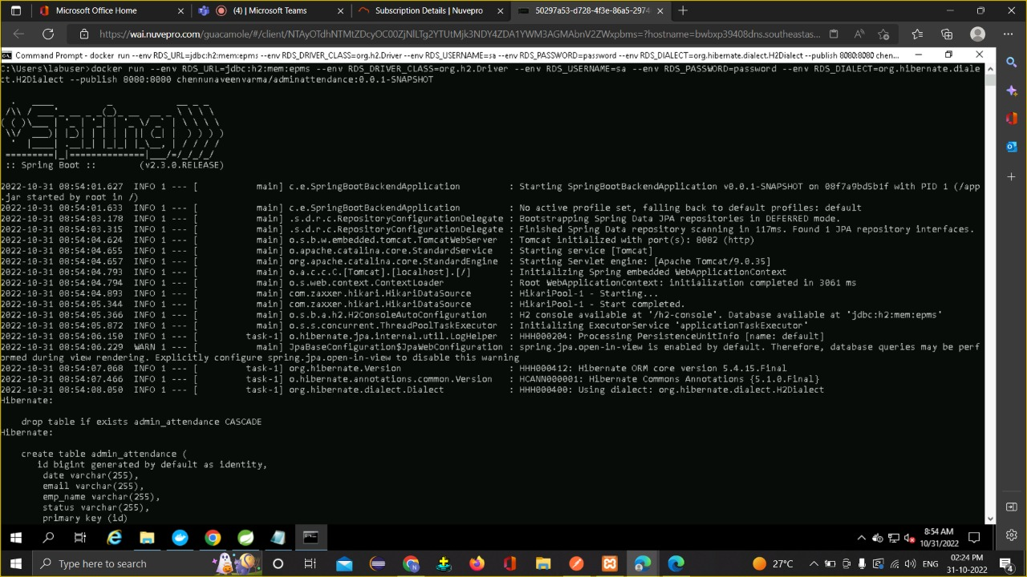
Docker Images Output : Admin Attendance

Slide 36
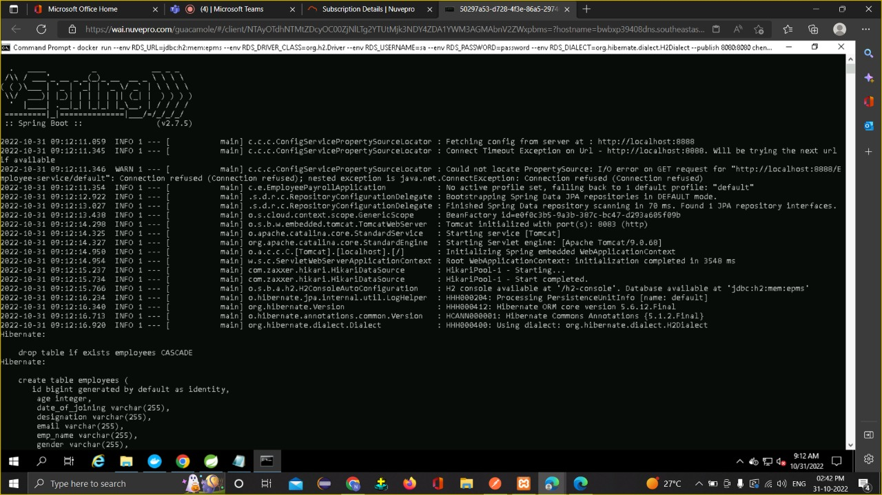
Docker Images Output : Employees

Slide 37
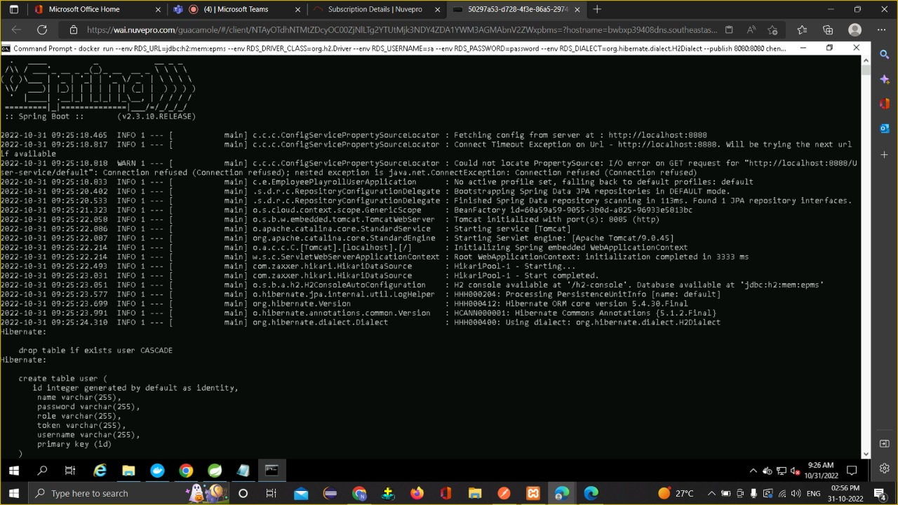
Docker Images Output : User

Slide 38
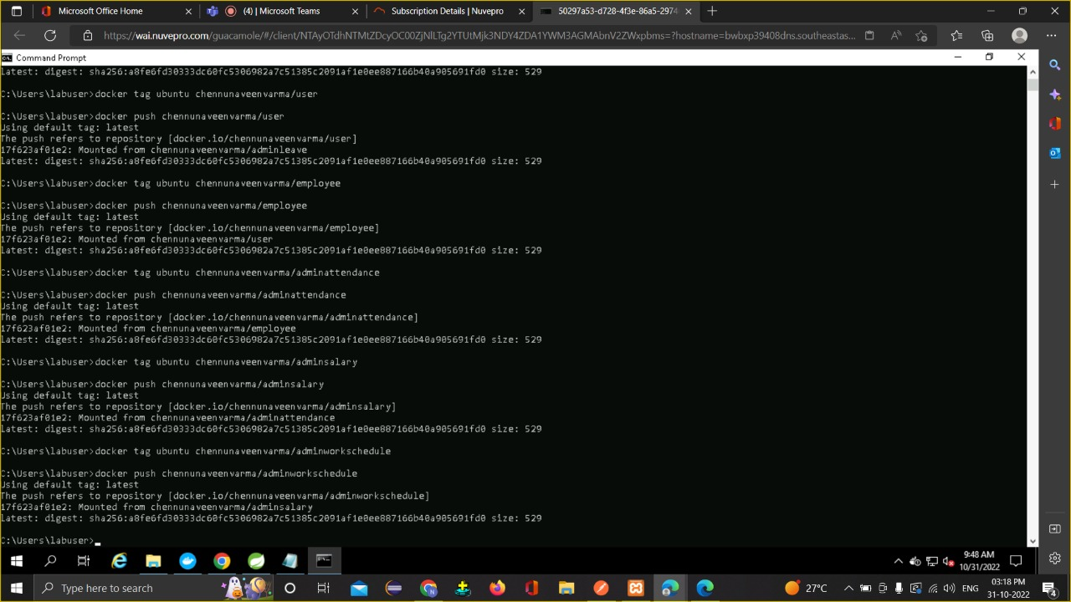
Docker Push

Slide 39
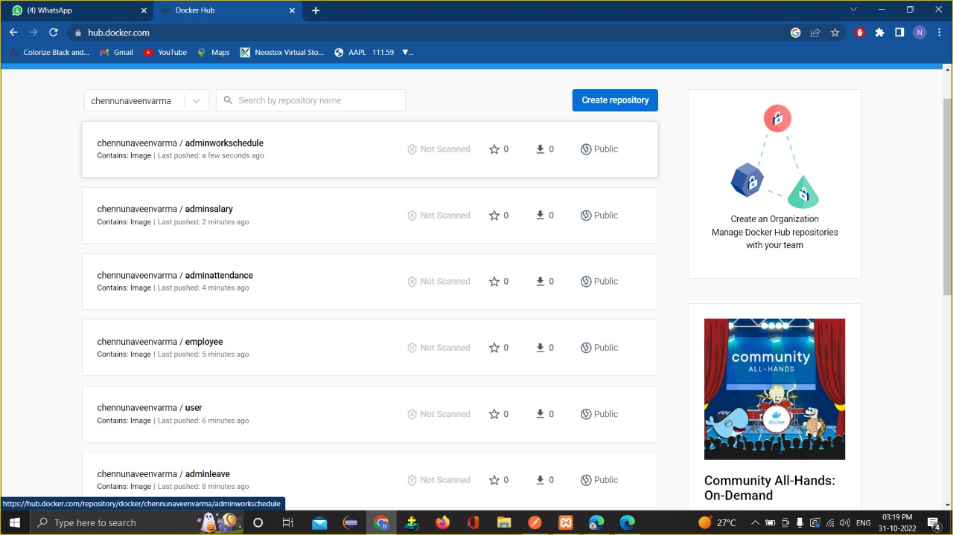
Docker Repository

Slide 40
Conclusion:
This project is built keeping in mind that it is to be used by only one user that is the admin. It is built for use in small scale organization where the number of employees is limited. According to the requested requirement the admin can add, manipulate, update and delete all employee data in his organization. The admin can add new departments and delete them. The records can be seen by admin at any time.

Slide 41
THANKYOU

